Slide 1

AIRLINE RESERVATION SYSTEM

Slide 2
MERN STACK WEB DEVELOPMENT
SKILL DEVELOPMENT PROJECT
Team Members:-
Team Leader:- SHRIYA PRADHAN
MEMBER 1:- D. ANANDA SAI KRISHNA
MEMBER 2:- N. ANIL CHANDRA MADHAV

Slide 3
MERN-Flight-Booking-Application
INTRODUCTION:-
A complete flight booking application made using MERN Stack (MongoDB, Express js, React js, Node js).
The Flight ticket booking app is composed of the following Features:

Slide 4
Front-End
Sign-In & Sign-Up Pages.
Has a profile page, which will display all information about the signed in user.
List of cities for users to choose from (starting city & destination city).
Final page has a boarding pass displaying component, it displays all passenger data and also generates a random number as a transaction ID.
Ticket Cancellation page will cancel the ticket which was booked.

Slide 5
Back-End
Uses Express js based application for the backend process.
Uses MongoDB atlas for storing the collections.
This version does not support dynamic seat data being stored from cloud.

Slide 6
Our Project Is Developed With The Following :
Visual Studio Code - A source code editor developed by Microsoft for Windows, Linux and macOS. It includes support for debugging, embedded Git control, syntax highlighting, intelligent code completion, snippets, and code refactoring
Node.js - Javascript runtime
React - A javascript library for building user interface
Axios - Promise based HTTP client for browser and node.js
Express js - Express is a minimal and flexible Node.js web application framework that provides a robust set of features for web and mobile applications.

Slide 7
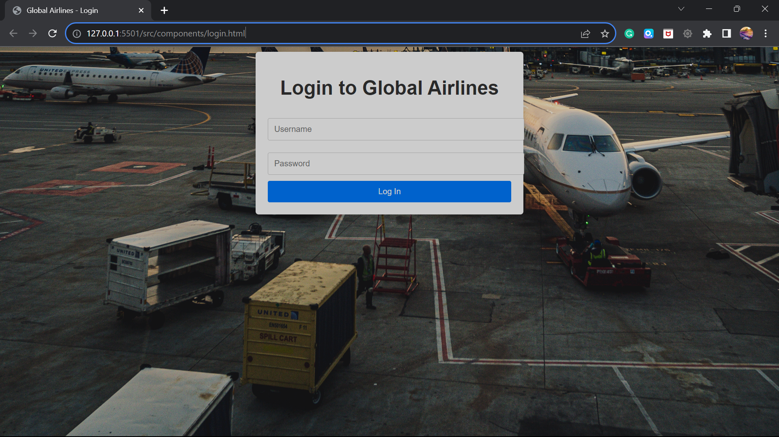

Slide 8
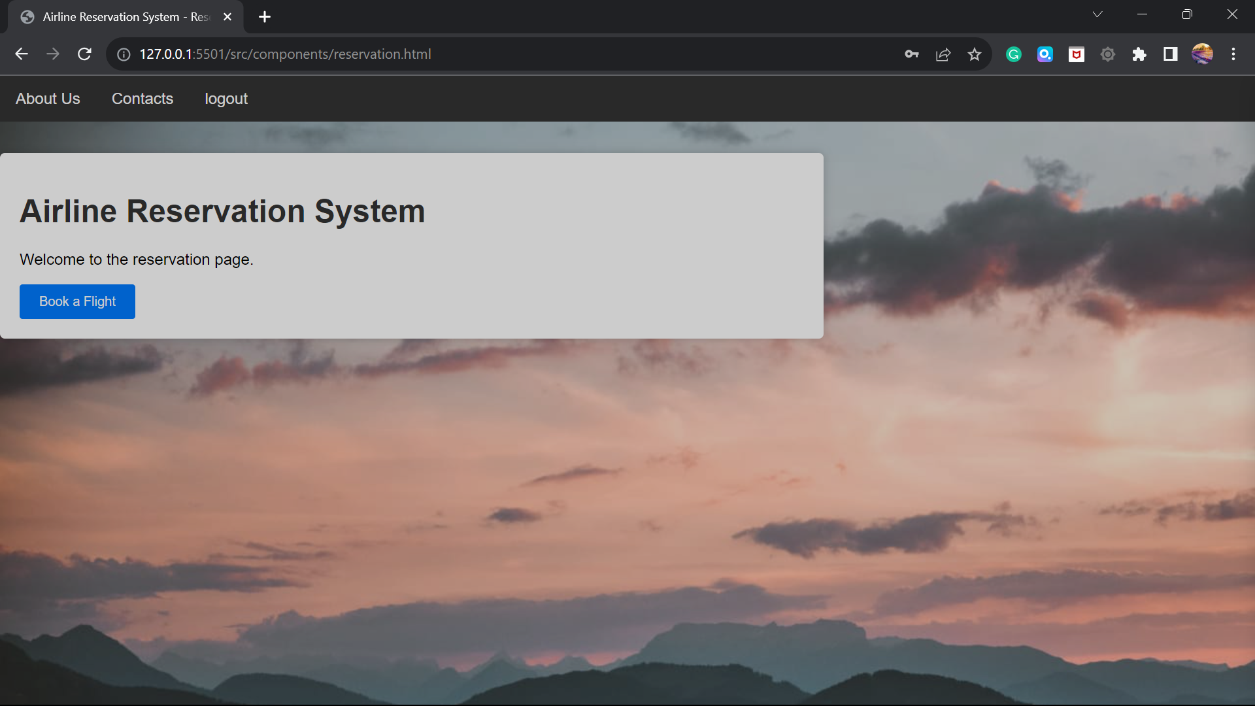

Slide 9
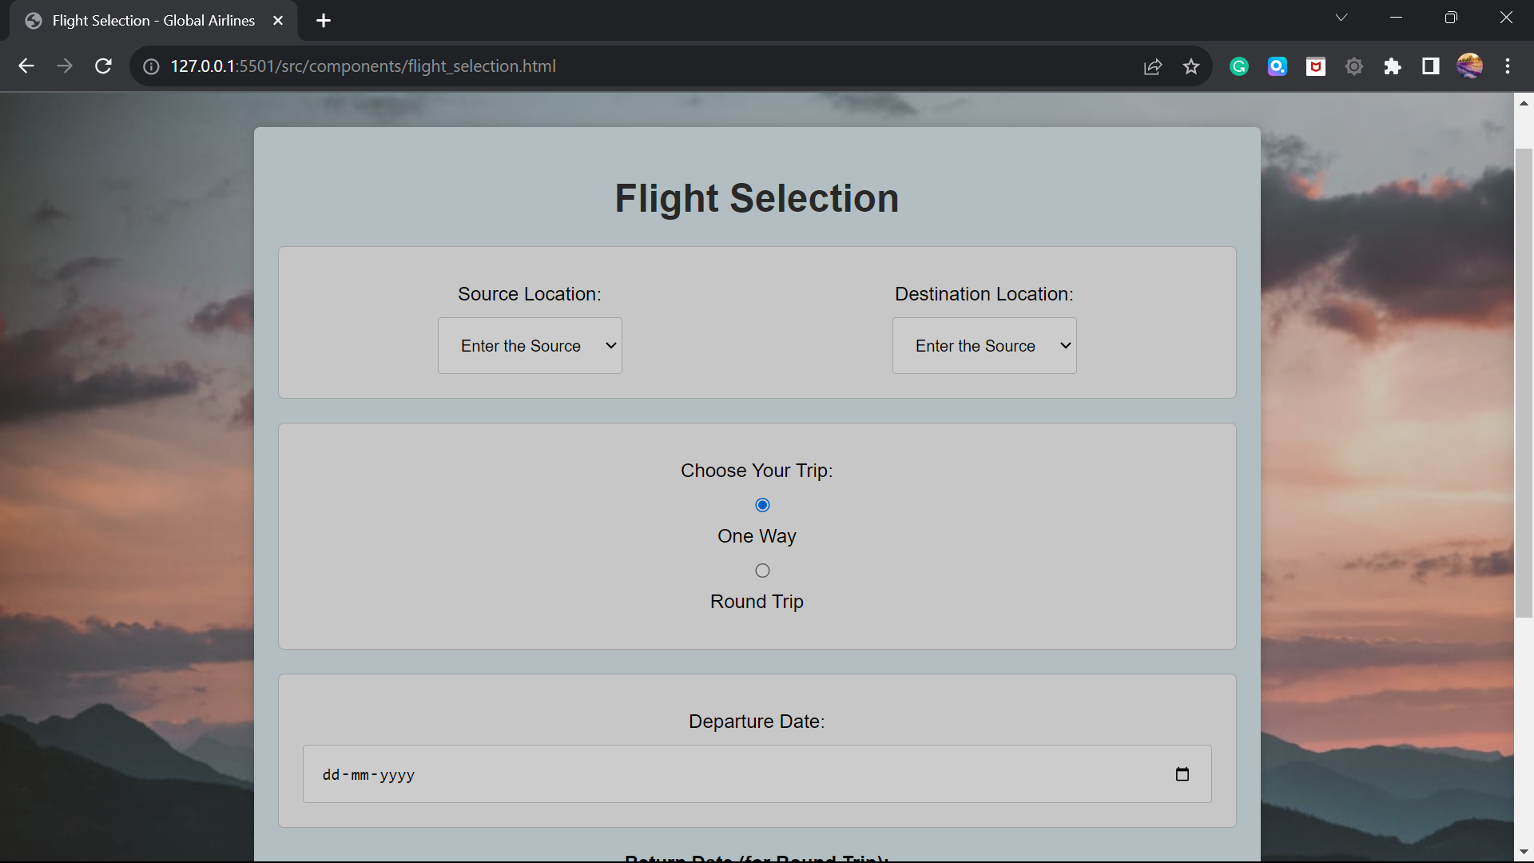

Slide 10
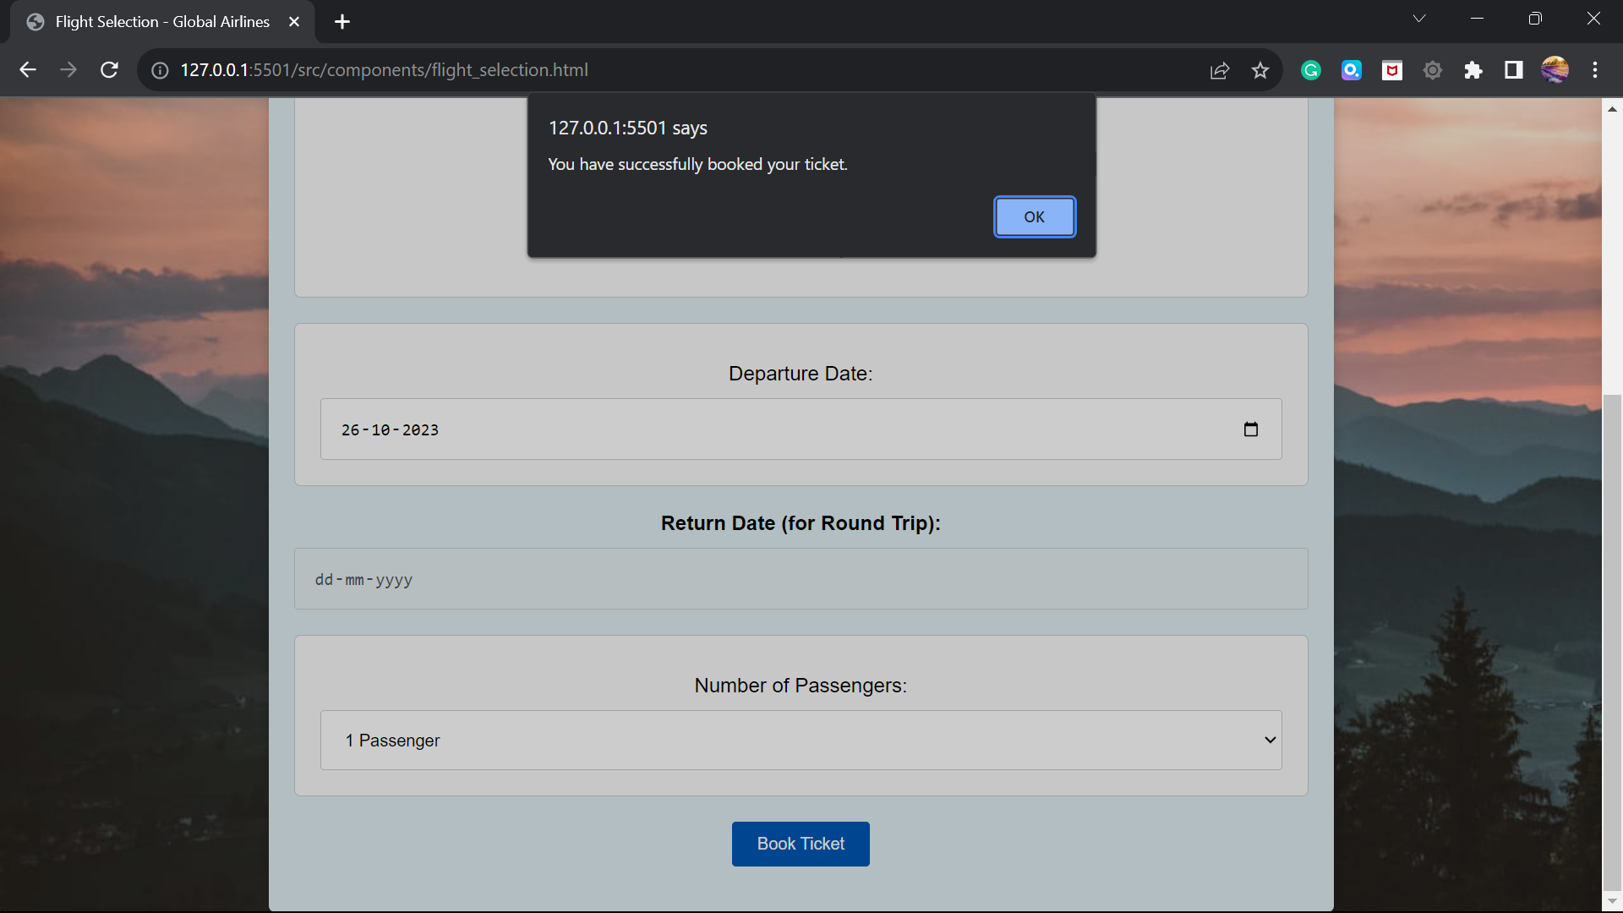

Slide 11
CHANGES MADE:

Slide 12
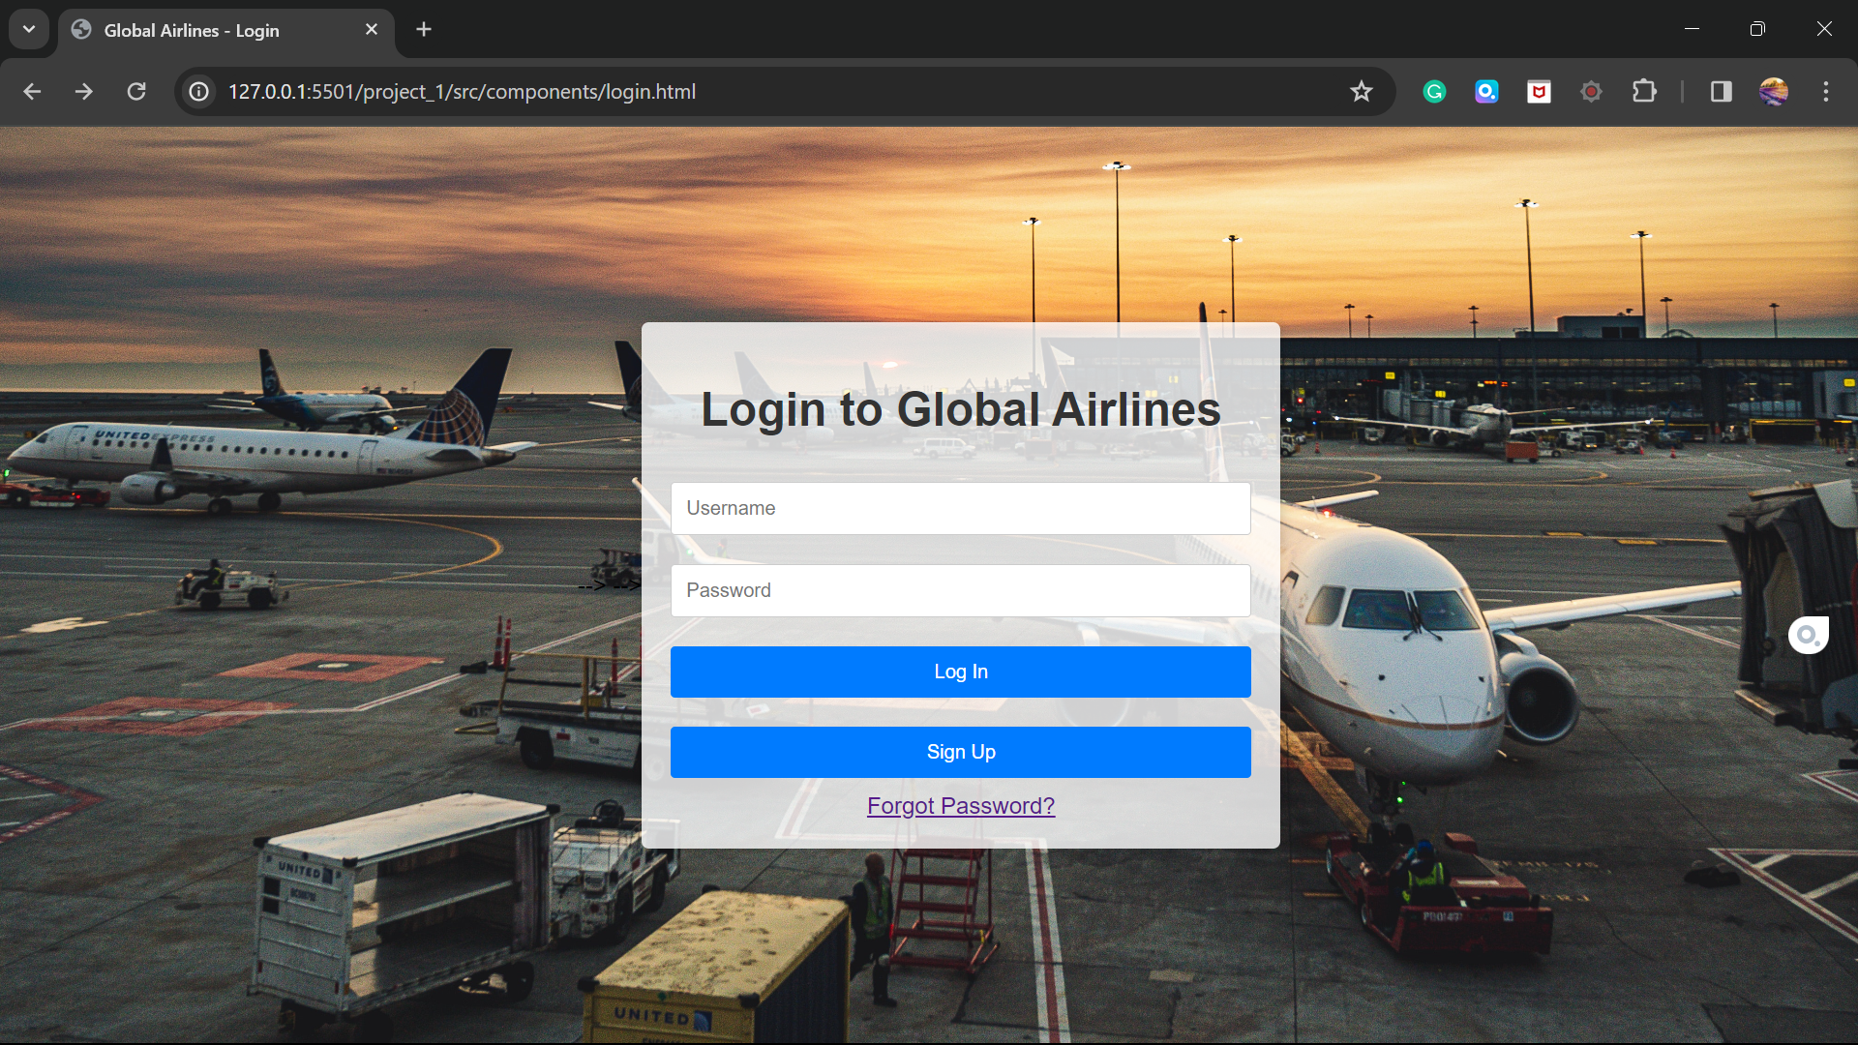

Slide 13
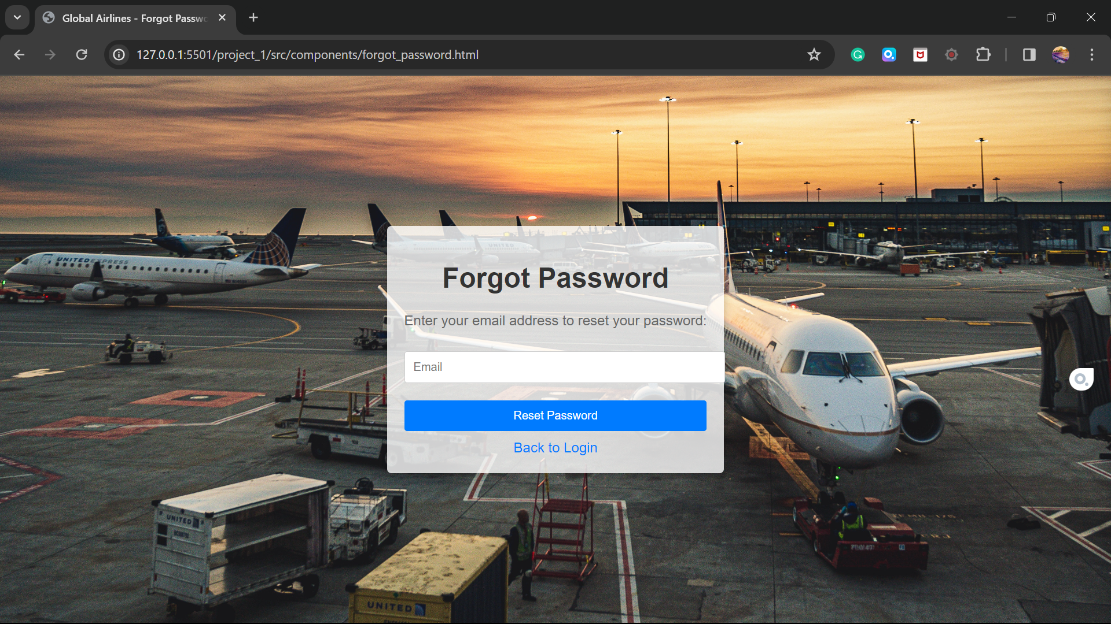

Slide 14
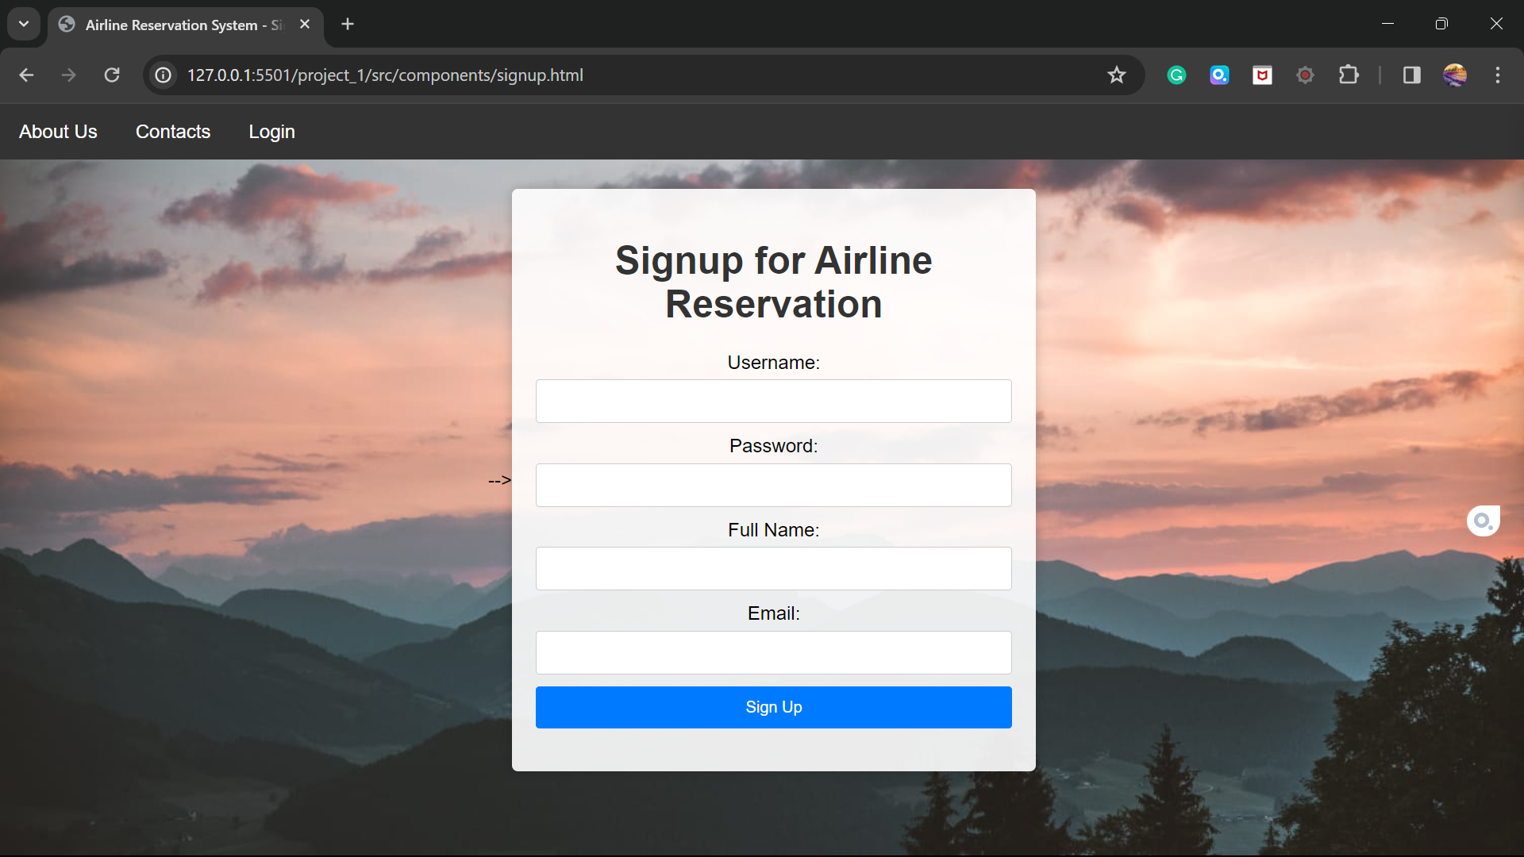

Slide 15
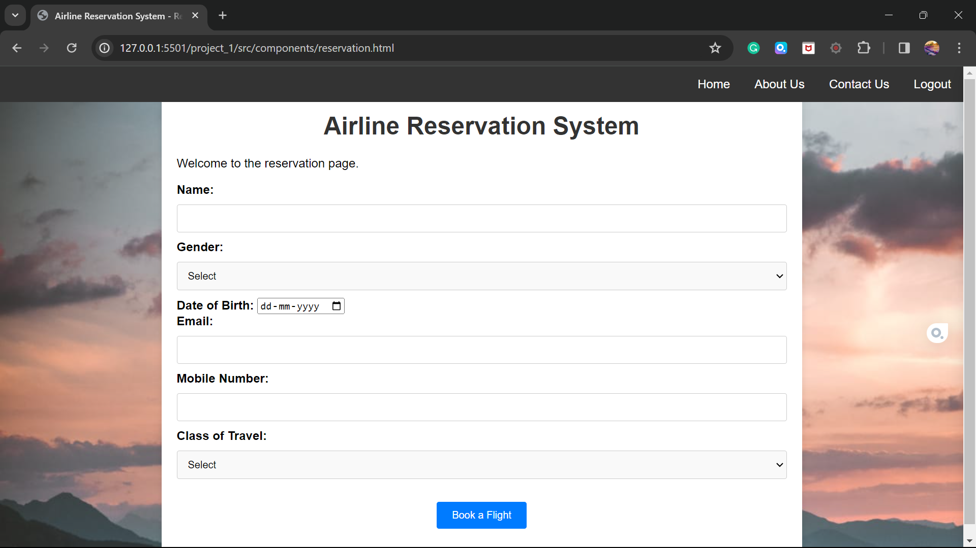

Slide 16
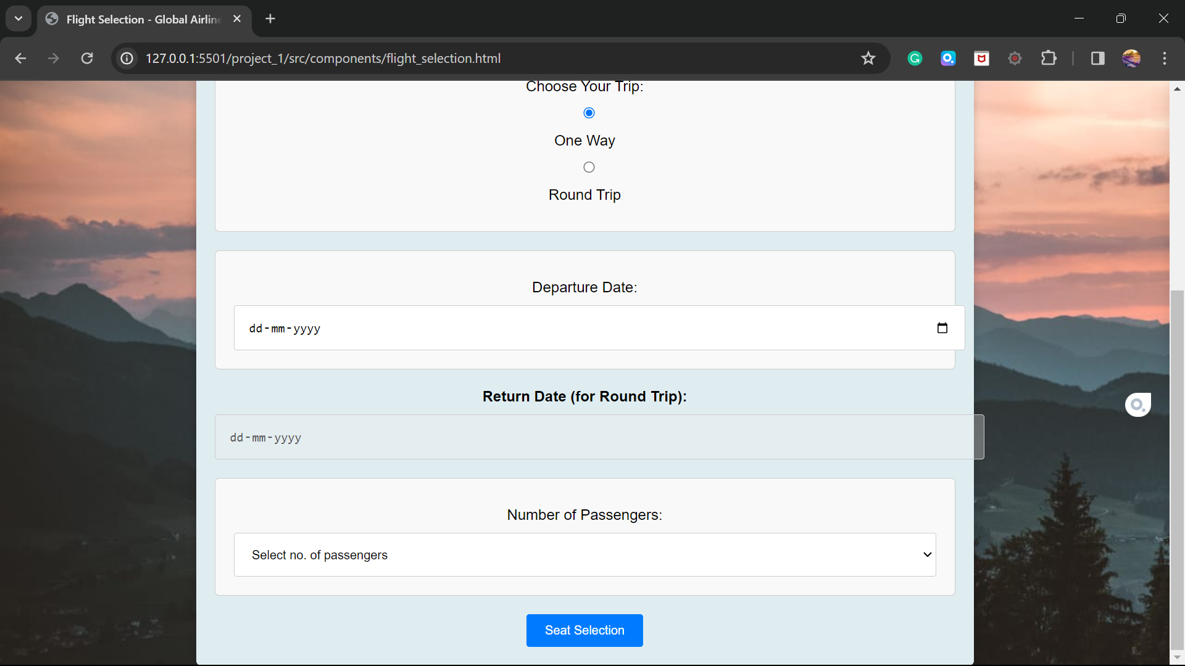

Slide 17
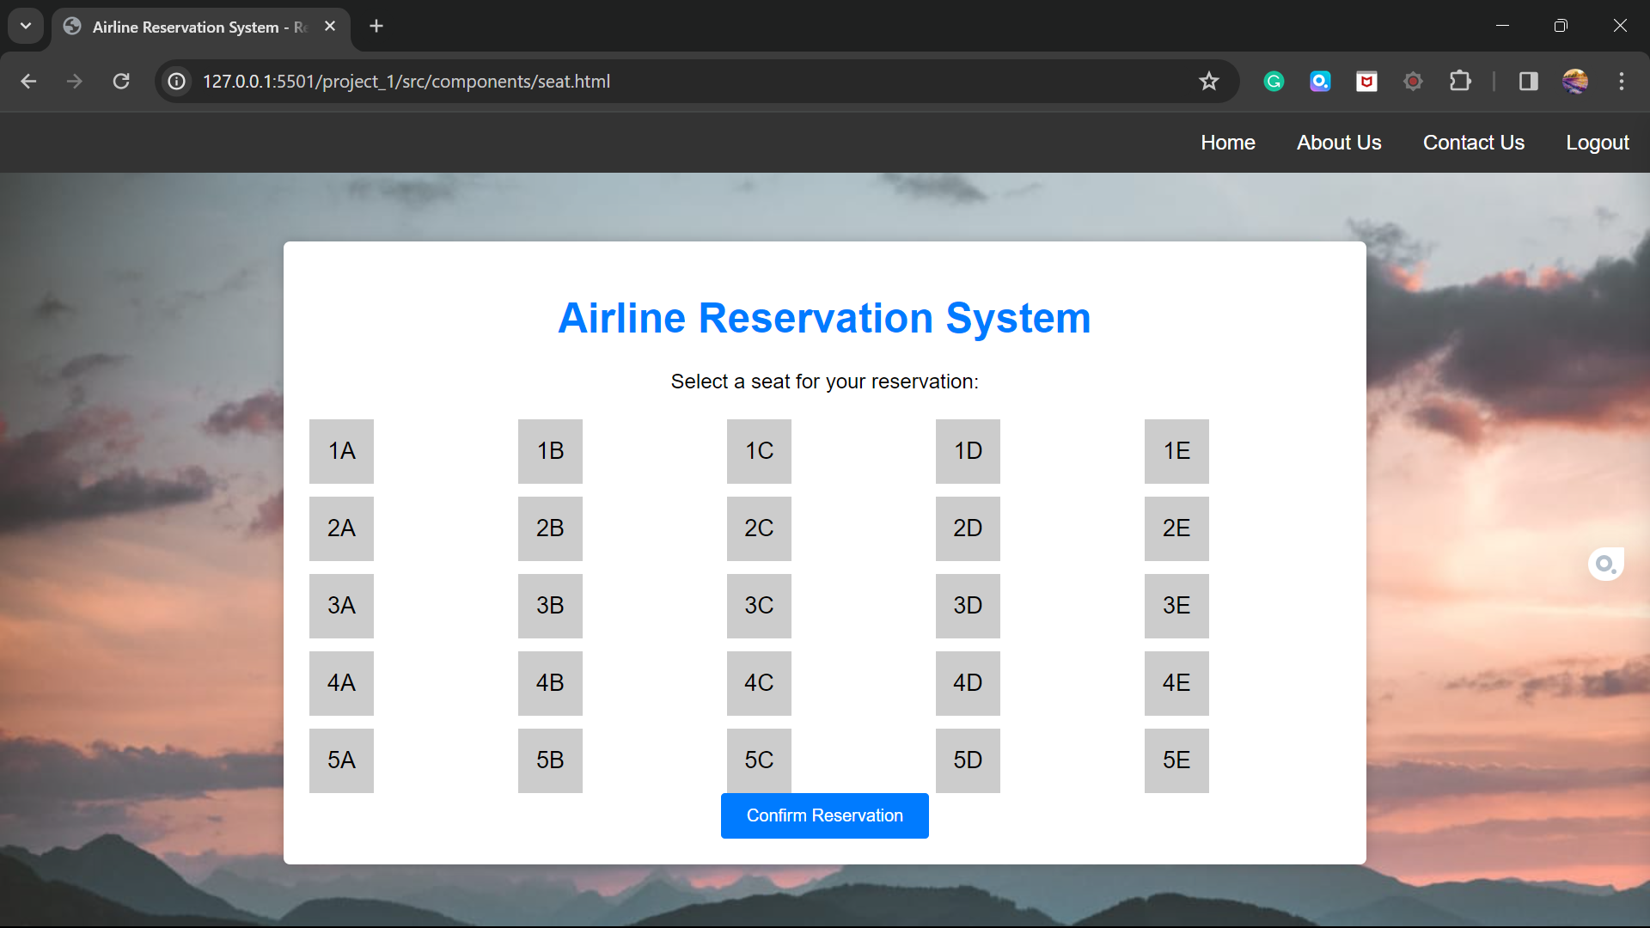

Slide 18
